Slide 1
Secret Management with
Hashicorp Vault and Consul on Kubernetes

Slide 2
Agenda
What’s a secret?
Secret management
Hashicorp Vault
Deployment topology
Demo
Q&A

Slide 3
What is a secret?
Anything is sensitive information
Database user, password
API keys
SSL keys
Encryption keys
Cloud credentials
Certificates
etc..

Slide 4
Why secret management matters
Moving fast of software development process and infrastructure
Micro-services based architecture: service to service communication via tokens, API keys, certificates
DevOps processes: multiple environments for development, testing, integration, and production
Cloud native application and multi-cloud infrastructure: secrets for storage,
compute, analytics, logging, etc..

Slide 5
Traditional secret management (anti-patterns)
Storing secrets:
Hard-coding
Clear text config files
SCM (git, svn)
Unencrypted file system (laptop, NFS)
Distributed secrets:
Email
Slack
Shared folder

Slide 6
Modern secret management
Modern secret management properties:
Secrets are encrypted at rest
Centrally managed
Access control to secrets
Auditable
Scalable
Easy to integrate
High automation for creating, revoking, rotating secrets
Supported

Slide 7
Hashicorp Vault
Modern secret management application
Secure secret storage (in-memory, Consul, file, and more)
Programmatic application access (automated)
Operator access (manual)
Leasing, renewal, revocation
Dynamic secrets
Rich ALCs
Multiple client authentication methods
Auditing

Slide 8
Vault Features
Secure secret storage:
Data is encrypted in transit and at rest
TLS for clients
No HSM required
Support many storages: in-memory, Filesystem, Consul, DynamoDB, Etcd, MySQL, PostgreSQL, S3, Zookeeper, etc..

Slide 9
Vault Features (cont.)
Leasing, renewal, and revocation:
Every secret has a lease
Secrets are revoked at the end of the lease unless renewed
Secret may be revoked early by operators
Auditing:
Pluggable audit backends
Request and response logging
Secrets hashed in audit log

Slide 10
Vault Features (cont.)
Dynamic credentials:
On-the-fly created credentials for each instance of an application or user
Usually short to medium TTL
Pluggable backends
Supported databases: MySQL, MariaDB, PostgreSQL, MSSQL, Oracle, MongoDB, Cassandra, Influxdb, etc...
Cloud: AWS, Google Cloud, Azure
SSH: one time password

Slide 11
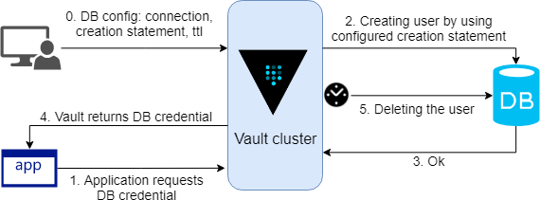
Vault Features (cont.)
How does dynamic credential work?

Slide 12
Vault Features (cont.)
Support multiple auth backends
Token
LDAP
Username & password
AppRole
AWS
Google Cloud
Kubernetes
…

Slide 13
Vault Features (cont.)
Support multiple auth backends
Token
LDAP
Username & password
AppRole
AWS
Google Cloud
Kubernetes
…

Slide 14
Vault Enterprise Features
Feature | Open source | Pro | Premium
Control Groups |  |  | X
Multi-factor Authentication |  |  | X
Read Replicas (performance standby) |  |  | X
Disaster Recovery (DR replication) |  | X | X
Replication (performance replication) |  |  | X
Replication Filters |  |  | X
Namespace |  | X | X
Auto unseal (AWS, Google cloud, Azure) | X | X | X

Slide 15
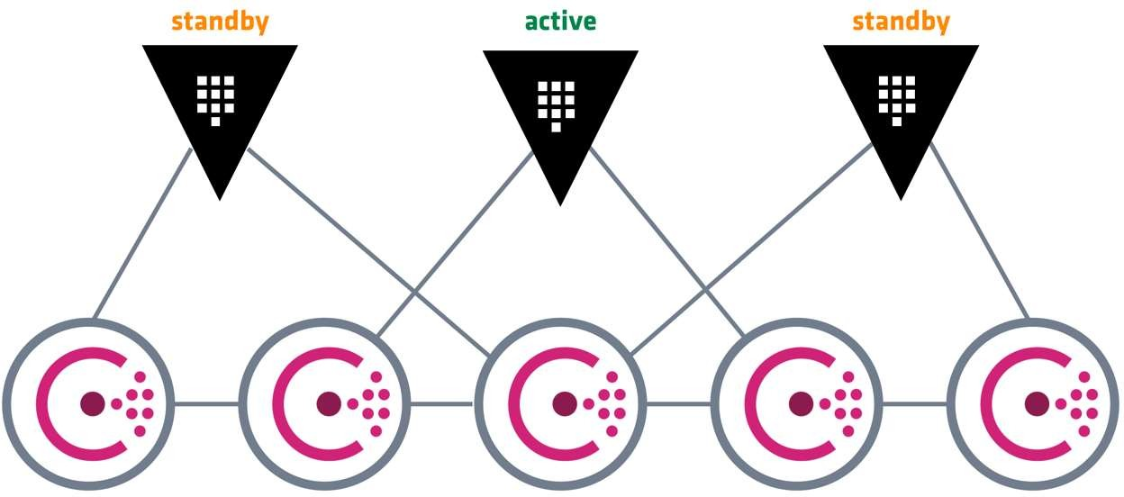
Vault Enterprise Features (cont.)
Performance standby node
Handle GET requests of key/value secrets and other requests that do not change underlying storage

Slide 16
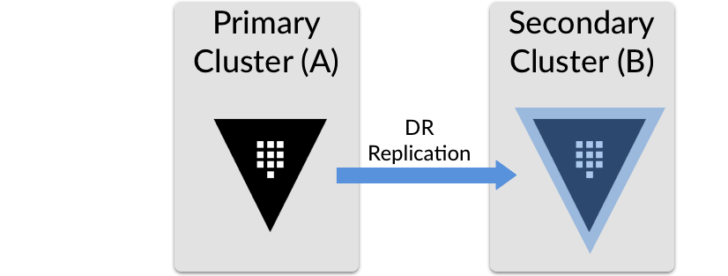
Vault Enterprise Features (cont.)
Disaster recovery replication (DR replication)
Replicated content, consistent across Vault clusters
Secret configurations
Access control policies
Authentication methods
Audit configuration
Tokens
Leases

Slide 17
Vault Enterprise Features (cont.)
Performance replication
Allowing Vault to scale relatively horizontally rather than vertically
Secondaries keep track of their own tokens and leases
If there is a request that modifiese underlying shared state, the secondary forwards the request to the primary to be handled; this is transparent to the client

Slide 18
Vault Enterprise Features (cont.)
Performance replication vs DR replication
Capability | DR | Performance
Mirrors the configuration of a primary cluster | Yes | Yes
Mirrors the configuration of a primary cluster’s backends (i.e.: auth methods, secrets engines, audit devices, etc.) | Yes | Yes
Mirrors the tokens and leases for applications and users interacting with the primary cluster | Yes | No
Allows the secondary cluster to handle client requests | No | Yes

Slide 19
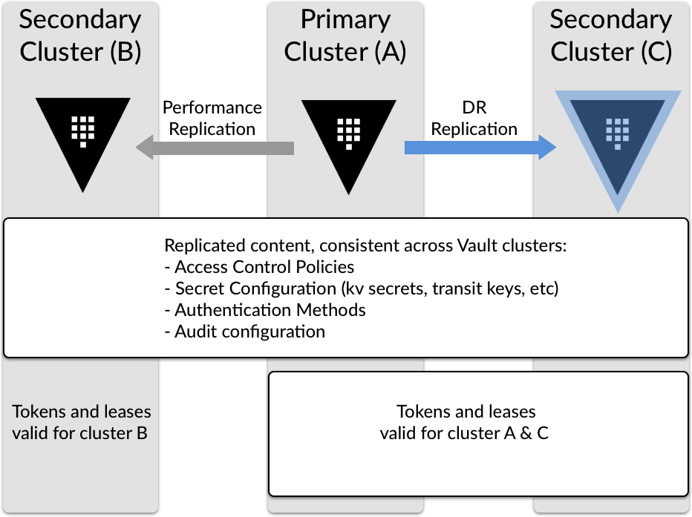
Vault Enterprise Features (cont.)

Slide 20
Understanding Seal and Unseal
Seal state:
When a Vault server first boots
When a Vault server is started
Vault servers do not know how to decrypt data
Unsealing is a process of constructing the master key (which is constructed by
Shamir’s secret sharing algorithms) to read decryption key to decrypt data
Unsealed state is remained until one of two thing below happens:
It is resealed via API
The server is restarted

Slide 21
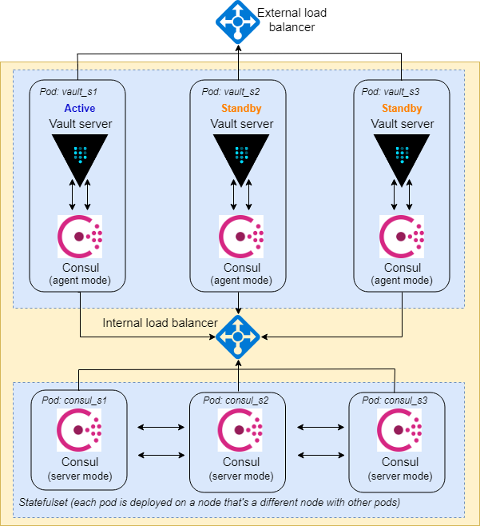
Deploy Vault on Kubernetes
Consul cluster is to serve as the storage backend for Vault since it supports HA mode
Only active pod replies to requests. Standby pods will redirect requests to the active one
Leader election is done backend
Refer here for details
in storage

Slide 22
Demo
Scenario 1: Legacy applications that don’t run on Kubernetes
Scenario 2: Legacy applications that run on Kubernetes
Scenario 3: New applications that use static credentials
Scenario 4: New applications that use dynamic credentials

Slide 23
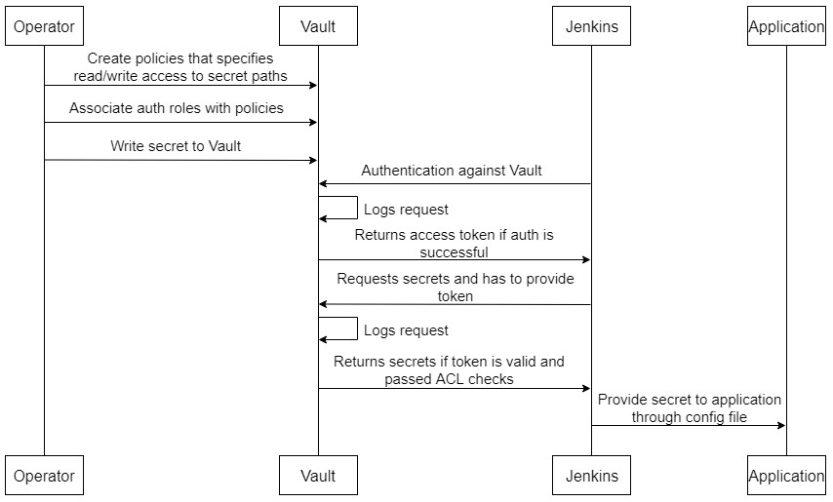
Scenario 1: Legacy applications that don’t run on k8s

Slide 24
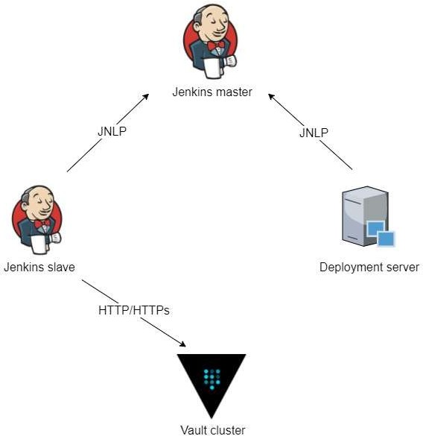
Scenario 1: Legacy applications that don’t run on k8s

Slide 25
Scenario 1: Legacy applications that don’t run on k8s
Jenkins master triggers a new build
Jenkins slave pulls source code from SCM, does necessary steps to build software packages and push to Artifactory if needed
The slave authenticates to Vault and gets required secrets that need for deployment steps
Deployment server gets software packages from Jenkins master or Artifactory and secrets. Doing necessary steps to deploy application

Slide 26
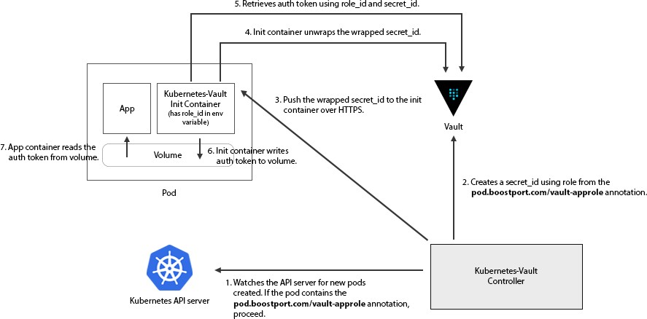
Scenario 2: Legacy applications that run on Kubernetes

Slide 27
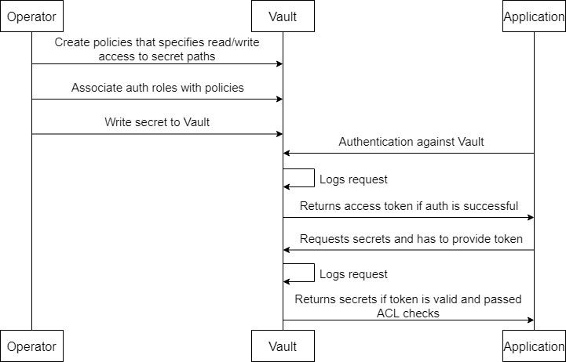
Scenario 3: New applications that use static credentials

Slide 28
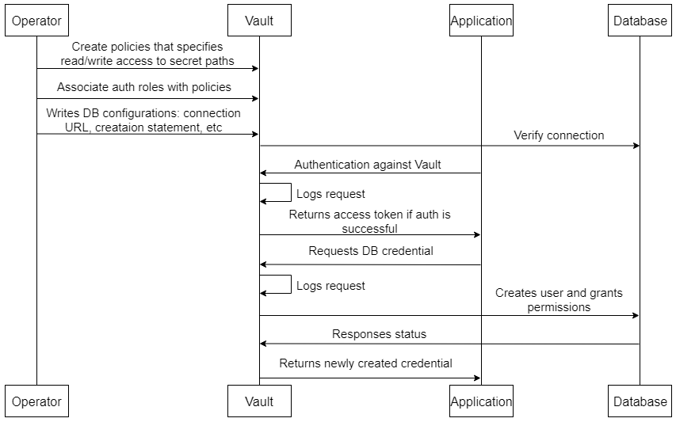
Scenario 4: New applications that use dynamic creds

